Slide 1
Caste and Caste Discrimination

Slide 2
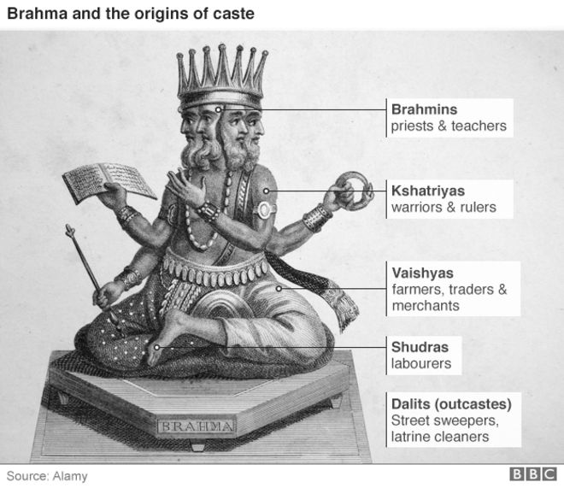

Slide 3
M.N. SRINIVAS – “DOMINANT CASTE”
In 1953 – through his study of Rampura Village (multi-caste village) Srinivas came up with the idea of “dominant caste”.
Dominant caste – numerically, economically and politically.
1950s – Srinivas came up with the idea of “ Western” – where an educated person by gaining the Western or non-traditional means of education can occupy a dominant position in the caste.

Slide 4
M.N. SRINIVAS – “DOMINANT CASTE”
Caste which occupies a dominant position in the caste hierarchy by having all the elements of dominance is seen as dominant in a decisive way.
This form of dominance is not common.
In the study of Rampura Village, Srinivas found that the Peasant (Okkaligas) caste enjoyed more than one element of dominance (numerically, economically and educationally).

Slide 5
Non-Brahmin Movement
At the end of the World War I – non-Brahmin leaders realised that they must get Western education to get important positions and power in the Government of Mysore.
Agitation started – institutionalisation of the scholarship, reservation of seats in medical and technical colleges and appointments to government posts.
Agitation succeeded and the measures led to Western educated non-Brahmin intelligentsia in the 1930s.

Slide 6
Caste Discrimination and Group Mobility
Untouchability constitutes a serious obstacle to the group mobility.
According to Srinivas, if a caste enjoys one form of dominance then it will be able to move up the ritual hierarchy if it Sanskritizes its ritual and way of life.
In 1948 – Untouchable leaders outside villages (Bihalli) asked the untouchables in the Rampura Village to stop performing services such as removing the dead cattle from the higher caste, removing leaves on which the high caste had dined, etc.

Slide 7
Caste Discrimination and Group Mobility
In the nearby village, Bihalli the Untouchable Caste stopped performing their assigned duties and the Bihali Peasants became annoyed at this and beat up the Untouchables and set fire to their huts.
In Rampura 1948 - the Government of Mysore sanctioned a sum of money to enable Untouchables in Rampura to have tiled roofs instead of thatch – the Untouchables claimed that they did not get readily from the Headman.
The dominant caste in both the cases were opposed to the emancipation of the Untouchables.

Slide 8
Different Caste Restrictions
According to Srinivas - the same caste may occupy different positions in neighbouring villages.
For instance, in Kere, Fishermen were not allowed to take their wedding and other processions into streets in which Brahmins and Peasants live, whereas in Malavalli Taluk villages where Fishermen were in the majority, no such disabilities affect them.
When the same caste occupies different positions in different villages, the segment of the caste which is occupying the lower position will be stimulated to move up in the local hierarchy.

Slide 9
Caste in the 21st Century
Caste as a Status Hierarchy
Caste system brings in social system of super ordination and subordination.
In Urban India – purity and pollution are difficult to maintain.
There might be differences existing among different castes but if it translates to social hierarchy is still a question.
Over time rituals and food habits of different castes have also seen a decline.
Caste as a System of Exclusion and Exploitation
Centuries of caste-based social organisation have left a legacy of inequality in access to land, education, business ownership and occupation.
Two aspects of caste inequalities deserve attention: inequality of opportunity and inequality of outcome.

Slide 10
Caste in the 21st Century
Caste in Transformation
Before independence many castes, and probably most, had more than half their working members in occupations other than those specifically associated with their caste
In an independent India the link between caste and occupation has weakened considerably.
Politics of affirmative action has further strengthened the power of lower castes with reservations in government jobs and higher education (Beteille 1992).

Slide 11
Overview of the Caste System
This idea of the dominant caste is an important development in tracking the evolution of the understanding of lived caste.
In contrast to the traditional view of Brahmins as superior regardless of material or numerical strength, Srinivas (1987) coined the term dominant caste to refer to those who were considered more locally dominant because of their numerical or material socioeconomic strength, regardless, to a certain extent, of their ritual purity.
Caste which was regarded as hierarchical and immobile groups – contested.

Slide 12
Overview of the Caste System
Caste is also a political construct in India.
The Indian Constitution recognizes three broad groups for its affirmative action or reservation policies.
The Scheduled Castes (SCs, a listing of predominantly ex-untouchable jatis).
The Scheduled Tribes (STs, a listing of geographically isolated groups) were identified via a schedule in the Indian Constitution in 1950 as groups deserving of preferential treatment in light of historical discrimination and disadvantage.
The third group, called the Other Backward Classes (OBCs), received reservations in the 1990s after much contentious debate and violence.
The definition of OBCs is more complex, as they are technically not simply castes or jatis, but classes.

Slide 13
Overview of the Caste System
Officially, however, the central listing of OBCs includes castes and communities considered socially, economically, or educationally “backward” by the National Commission for Backward Classes.
Ex - OBCs include groups of jatis such as the Yadavs (originally a caste of cowherds) in states such as Rajasthan and Uttar Pradesh.
They form the “bulk of the Shudras— the fourth category (varna) of the classical Hindu social arrangement” ( Jaffrelot 2000, p. 86), while the ex-untouchables form the bulk of the SCs.
SCs, STs, and OBCs receive a particular number, in proportion to their population, of reserved seats in the public sector, educational institutions, and some legislative institutions (see Galanter 1984; McMillan 2005, Srinivas 1996).

Slide 14
Overview of the Caste System
Critics of these reservations have argued that it solidifies caste identity, whereas supporters have emphasized the need for corrective procedures to help these castes overcome centuries of oppression and discrimination (Srinivas 1996a).
Caste can be understood in many ways, but the constitutional categories of SC, ST, and OBC arguably have a greater importance in the political domain and with regard to affirmative action.
Caste is not restricted to Hindu society nor to communities in India alone. Caste exists in a variety of forms in other religions in India, leading to a hierarchy of ritual status in these religions as well [for castes among Muslims, see Ahmed (1978), Bhatty (1996), and Fanselow (1996); for castes among Christians, see Tharamangalam (1996)].

Slide 15
Overview of the Caste System
A recent study on “caste and discrimination” in four South Asian countries—Pakistan, Nepal, Sri Lanka, and Bangladesh by Jodhka and Shah (2010) —underscores the existence of caste and caste-like discrimination outside of India.
Jodhka and Shah (2010) report through their fieldwork in these 4 countries that -
“even when meanings of untouchability or even its sources (religion or tradition) vary across regions, as also its forms, from physical touch and residential segregation to taboos and restrictions on inter-dining, physical movement or pursuing occupations of one’s choice, its effects on those placed at the bottom are quite similar, viz. economic deprivation, discrimination and a life full of humiliation” ( Jodhka & Shah 2010, p. 2)

Slide 16
Overview of the Caste System
Furthermore, research among the Indian diaspora has highlighted the persistence of caste, especially in social relationships and religious practice (Borbas et al. 2007, Kumar 2004, Metcalf & Rolfe 2010).
For example there are certain Gurudwaras or Sikh places of worship in the United Kingdom that are frequented by low-caste Sikhs only.
In light of the Indian government’s policies to redress the inequalities suffered by the backward castes and tribes, Sanjay Kumar, Anthony Heath and Oliver Heath (2002) set out to study whether these political and social movements have made India a more mobile society in the past five decades. In their first paper (2002b), they lay out the trends in mobility of men, and in the second (2002a), they study the determinants of this mobility.
Using the 1971 and 1996 male-only National Election Study (NES) data (a large, individual level, nationally representative data set), they conclude that “there has been no systematic additional weakening of the links between father’s and son’s class positions, or between caste and class” (Kumar et al. 2002a, p. 4096).

Slide 17
Overview of the Caste System
The role of castes as interest groups in the political arena has also been a subject of many debates and is another indicator of the adaptive nature of caste ( Jaffrelot 2012, Shah 2004).
For instance, the Bahujan Samaj Party, which has gained popularity in Uttar Pradesh and other northern states, is an example of a party geared specifically to those at the margins.
Srinivas (1962, p. 5) suggests that “for purposes of sociological analysis a distinction has to be made between caste at the political level and caste at the social and ritual level”.
In sum, the caste system has clearly evolved and adapted to socioeconomic and political changes. Whereas some of its characteristics

Slide 18
Overview of the Caste System
Whereas some of its characteristics (such as practicing pollution) are slowly, although not entirely, disappearing from the public sphere, others (such as voting on the basis of caste identity) have led to caste becoming a part of contemporary political language.
Caste has evolved over time but has been quite resilient as an institution and has not disappeared altogether.

